Slide 1

National Institute of Technology Agartala
TOPIC : POWER FACTOR IMPROVEMENT METHODS
NAME – SHASHWAT SAROJ
ENROLLMENT NO.- 21UEE043
SEMESTER-3rd
DATE- 29/08/2022
SLIDE NO.- 01

Slide 2
KEY CONTENT
INTRODUCTION
DEFINITION
CAUSES OF LOW POWER FACTOR
METHOD OF IMPROVING POWER FACTOR
ADVANTAGES OF GOOD POWER FACTOR
CONCLUSION
EQUIPENT USED FOR IMPROVING POWER FACTOR
DATE- 29/08/2022
SLIDE NO.- 02

Slide 3
INTRODUCTION
The most AC electrical machines draw apparent power in terms of kilovolt-amperes (KVA) and Active power measured in kilowatts( KW) which is inexcess of the useful power required by the machine.
All AC machines (motors , transformer) have two types of Power: active and reactive power. The active power is entirely transformed into mechanical power(work) and heat(loss). The reactive power is used to magnetize the circuits of electrical machines and Various inductive loads used in all industries deals with the issues of power factor.
DATE- 29/08/2022
SLIDE NO.- 03

Slide 4
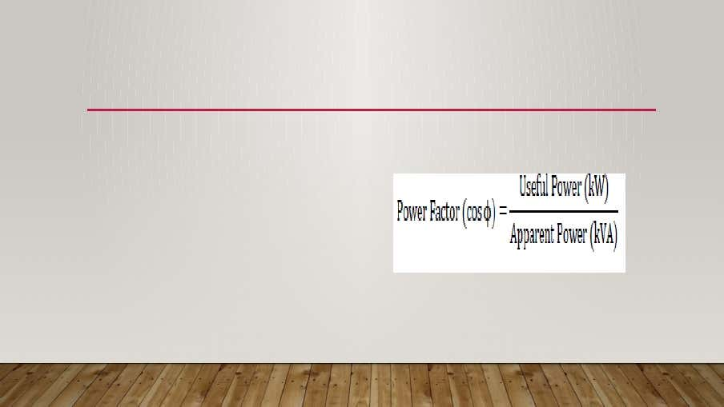
DEFINITION
The ratio of these quantities Active power to apparent power (KW/KVA) is called the power factor and is dependent on the type of machine that is used , or the ratio of resistance to the impedence is called power factor . The cosine angle between the voltage and current are also referred to as power factor.
DATE- 29/08/2022
SLIDE NO.- 04

Slide 5
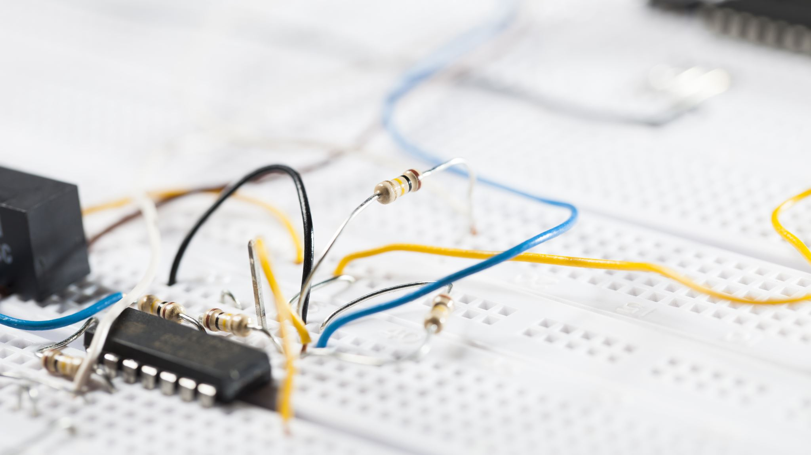
CAUSES OF LOW POWER FACTOR
A great proportion of electrical machinery used in industry has inherently low power factor and it depends on the following equipment.
Some equipment or machinery with low power factor are listed below:
1.Welding machine
2.Induction furnaces and Electric Arc
3. Induction motor of all types
4.Power thyristors installation
5. Fluorescent lighting
6. Induction furnaces and chock coil
DATE- 29/08/2022
SLIDE NO.- 05

Slide 6
METHODS FOR IMPROVING POWER FACTOR
The methodology employed to improve the power . The power factor involves introducing Reactive power (KVAR) into the system in phase opposing to the wattles or reactive current. The standard practice is to connect Power capacitors in the power system at appropriate places to compensate the inductive nature of the loads. The apparent power (KVA) in AC circuit can be resolved in two components, in phase component which supplies the useful power (KW),and the Wattles component (KVAR) which does no useful work. The vector sum of the two is the apparent power (KVA) drawn from the supply. The cosine of the phase angle between apparent power (KVA) and Active power (KW) represent the power factor of the load . To improve the power factor, equipment drawing Reactive power (KVAR) of approximately the same magnitude as the load Reactive power (KVAR), but In phase opposition(leading) is connected in parallel with the load.
DATE- 29/08/2022
SLIDE NO.- 06

Slide 7
EQUIPMENT USED FOR POWER FACTOR IMPROVEMENT
A. Synchronous Condenser
It is a synchronous motor that rotates under no load condition. A synchronous motor shows capacitive behavior while operating in overexcited mode. By controlling the field excitation power factor can be adjusted continuously. It provides step-less PF correction and not affected by system harmonics. But its installation and maintenance is costly
B. Static Capacitor Bank
Capacitors causes leading power factor as it shifts current ahead of the voltage. So to correct lagging power factor, it is a convenient method for which this method is practiced worldwide vastly. Though it has some limitations like the inability to absorb harmonics and doesn’t provide step-less correction, it is a popular choice for PFC, for its low cost of installation and maintenance.
DATE- 29/08/2022
SLIDE NO.- 07

Slide 8
ADVANTAGES AND DISADVANTAGES
GOOD POWER FACTOR
1. Reduction of electricity bills
2. Extra apparent power (kV)A available from the existing supply
3. Reduction of power (I²R) losses in transformers and distribution equipment
4. Reduction of voltage drops in long cables.
5. Reduced electrical burden on cables and electrical components
LOW POWER FACTOR
1. Great conductor size
2. Larger cooper losses
3. Larger apparent power (KVA) rating of Equipment
4. Poor voltage regulation
5. low capacity of the system
DATE- 29/08/2022
SLIDE NO.- 08

Slide 9
CONCLUSION
As results, after the installation of suitable sized capacitors into the Network the power factor can be improved and the value become closer to 0.9 up to 0.95, Then the capacitor bank used for power factor correction minimize the losses and increases the efficiency of the power system as well as to increase the stability at the same time.
Briefly after using appropriate power factor improvement devices ,the efficiency of power system is highly improved or increased. The improvement of the power Factor causes the utility companies to get reduced from power losses in the case the consumers are free from low power factor penalties charges.
DATE- 29/08/2022
SLIDE NO.- 09

Slide 10
REFERENCES
[1] A. Chandra and T. Agarwal, “Capacitor Bank Designing for Power Factor Improvement,”
International J. Emerg. Technol. Adv. Eng. Jetae , vol. 4, no. 8, pp. 235–239, 2014, doi: 10.1016/0957-4166(94)80092-8.
[2] R. Orman, Power Factor Correction Solutions & Applications Power factor definition. 2012.
[3 ]L. W. Burrett, “The disadvantages and improvement of low power factor,” Students Q. J., vol. 13, no. 50, p. 45, 1942, doi: 10.1049/sqj.1942.0045.
[4] R. K. Garg, S. Ray, and N. Gupta, “Reactive power compensation and power factor improvement using fast active switching technique,” 1st IEEE Int. Conf. Power Electron. Intell. Control Energy Syst. ICPEICES2016 , 2017, doi: 10.1109/ICPEICES.2016.7853166.
[5] A. A. Sallam and O. P. Malik, “Power Factor Improvement,” Electr. Distrib. Syst. pp. 361–379, 2011, doi:10.1002/9780470943854.ch9.
DATE- 29/08/2022
SLIDE NO.- 10

Slide 11
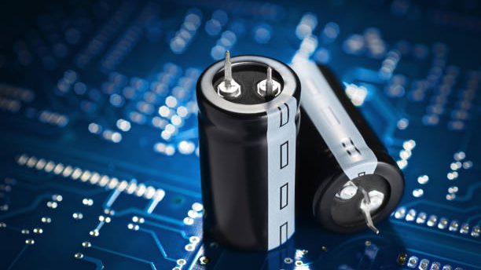
THANK YOU
DATE- 29/08/2022
SLIDE NO.- 11

